Slide 1
Module 8, Capstone Portfolio Project
Robert nicholson
Colorado State University Global
MIS581 – capstone: business intelligence & data analytics
Dr. Justin Bateh
October 9, 2022

Slide 2
Executive Summary
The contribution to the transportation field of study, and the objective of this paper, is to determine the viability of reducing the physical space of car lanes. The objective will be met by analyzing demographic data for the city of Dallas and correlate to the findings and observations with cities showing successful cycling infrastructure. The overall analysis can then be associated with the probability of success in Dallas and its surrounding neighborhoods.
Research Component | Analysis
Research Problem | The prominence of developing a reliable economic restoration plan specific to the urban environment has long been recognized by urban planners and city leaders as having value to social equality and economics Many city projects have the best intentions, but are oftentimes shelved, underfunded, delayed, or just abandoned leaving urban areas none the better. In Dallas’s downtown area, vehicle volume across primary arterials is hovering in the hundreds of thousands per day despite being built to only handle tens of thousands per day (A New Dallas, 2021). This ultimately leads to a visually recognizable problem, as well as an economically decline to Dallas’s urban environment.
Research Objective | Determine viability of reducing physical car lane space Correlate successful cycling infrastructure with economic and social enhancements; predict viability if applied to Dallas Analysis will confirm or reject hypothesis
Solution | Reduce car lane width from 12 feet wide to 10 feet wide; reallocate space to cycling infrastructure Applied primarily to urban areas with space limitations Connect urban infrastructure to suburban infrastructure Promote employment opportunities, business opportunities, housing opportunities; associate with cycling infrastructure investment Can impact policy
Notes:
The decline of the urban setting has been a troubling reality for decades that brings with it both a physical crumbling of tangible infrastructure and the often-overlooked social inequities that afford some areas with public infrastructure benefits while not affording the same benefits elsewhere. Hortas-Rico (2015) establishes post-war suburbanization as a leading driver that is reshaping the spatial pattern of growth impacting several urban and larger metropolitan cities throughout the United States.

Slide 3
The Research Question
The study leveraged these research questions to drive the analysis of the data. Van Eijk et al. (2022) highlight the focus on how a single research question may lead researchers to determine the correct the type of model(s) and defining parameters for a study.
The study begins with the primary research question, can reducing the lane space allotted for vehicles lead to strategic investment in cycling infrastructure in Dallas?
Research
Question
Does an increase in protected bike lanes have a correlation to an increase in economic development within urban environments?
Will an increase in cycling infrastructure investment lead to breaking the social inequities across urban neighborhoods?
Supporting
Questions
Notes:
Using this same concept, the focus on the holistic question will dictate each supporting question’s modeling approach and how the analysis will be performed to ultimately prove or disprove the hypothesis.

Slide 4
The Research Hypothesis
Can reducing the physical lane space allotted for vehicles lead to strategic investment in cycling infrastructure in Dallas?
H_{O}: Reducing the width of vehicle lanes does not lead to strategic investment in cycling infrastructure.
H_{A}: Reducing the width of vehicle lanes does lead to strategic investment in cycling infrastructure.
Research
Question
When designing the research hypothesis for this study, the following factors were assessed:
Controversy
Actionable Solution
Future Research
Controversy
Actionable
Solution
Future Research
Null
Hypothesis
Alternative
Hypothesis
Notes:
The hypothesis is based on the controversial portion of the research problem. Answering this may lead to additional discussion regarding how can investment in cycling infrastructure take place and how to promote driver adoption of car lane width reduction.

Slide 5
Literature Review
The reduction of vehicle lane space to make room for cycling infrastructure is a controversial topic, especially when looking at a city where cars and trucks are embedded into the cultural norm. But it is important to look at the potential benefits to economic and social inequities that investment in cycling infrastructure can bring. Ultimately, the study will seek to have impact on urban planning and revitalizing Dallas’s urban areas.
Literature Source | Literature Overview
Protected Bike Lanes Means Business: How 21st Century Transportation Networks Help New Urban Economies Boom | Economic and Social Inequities Protected bike lanes create safe and appealing experiences for all types of utilitarian cyclists Protected bike lanes promote new businesses to open along the routes Highlights repeat business as the amount of purchased goods cyclists can carry is limited Cycling infrastructure connects communities
Equity impacts of cycling: examining the spatial-social distribution of bicycle-related benefits | Economic and Social Inequities Encompasses the grass roots organizations becoming the catalyst to promote the socio-economic aspects that break inequity barriers Cycling infrastructure, when distributed equally, the benefits can be realized by entire and connected communities, not just a single group of individuals Empirical evidence has shown that equity issues have been far less addressed during bicycle planning and decision-making processes
Disparities in Bicycle Commuting: Could Bike Lane Investment Widen the Gap? | Dissenting Opinions Addresses the opposite view that investing in cycling infrastructure further negatively impacts disenfranchised groups as cycling infrastructure trends away from urban areas Identifies planning for an increased volume of motor vehicles is needed for future growth of the suburban landscape
Who were these bike lanes built for? Social-spatial inequities in Vancouver’s bikeways, 2001-2016 | Dissenting Opinions Challenges for communities to access bike lanes continue to persist Confirms areas with higher educated adults have more access to protected bike lanes leading to disparate opportunities amongst communities Areas that contain higher numbers of children have less access to protected bike lanes that further support disparities
Notes:
The study does not explore the use of cycling infrastructure for sport cycling, e.g., competitive racing and/or distance events, but it should be known that cycling infrastructure will be used by all types of cyclists. However, utilitarian cycling was the focus for this study; utilitarian cycling is commuting and running daily errands or Point A to Point B micro mobility.
There are ample peer-reviewed sources available that highlight the benefits of cycling and the corresponding cycling infrastructure, bike lane safety, and economic growth of urban areas that support cycling infrastructure. Many of the studies conducted have concluded a favorable view for investment in cycling infrastructure, and while transformation to successful cycling infrastructure has not been an overnight occurrence, the studies have generally shown evidence exists to support the opportunities that result in positive economic prosperity, connecting communities, and lower health expenditures.

Slide 6
Research Design
The study will leverage a series of datasets to support the data modeling and analytics component of this project. Attention was afforded to identify useable datasets that could be analyzed; the selected datasets can be rooted back to two primary sources: the United States Census Bureau (Census) and the Texas Comptroller of Public Accounts (TCPA).
Discovery & Data
Research Plan
Results & Analysis
Research Design
Data
Influences
Existing
Research
Project
Guidelines
Linear Regression &
Confidence Levels
Predictive Analytics
Literature Review &
Comparison
Additional Research
Opportunities
Influence on
Cycling
Infrastructure
Address Economic
& Social Inequities
Observation
Discussion
Correlate Successful
Cycling Infrastructure
Actionable Solutions
Understand
Research
Problem
Formulate
Hypothesis
SAS Studio
Hypothesis Testing
Modeling methodology
Notes:
Methods
As for the testing method, the SAS features used were: 1) Linear Regression to better understand the correlation between employment and housing in Dallas, 2) Predictive Regression Models to forecast the causal impact of cycling infrastructure on economic and social inequities, and 3) Partial Least Squares Regression to reduce the factors and work with a smaller set of predictors to further support the predictive analysis.
Limitations
The only known data limitation was with the United States Census Bureau collection methods that might have contained unasked and unanswered questions specific for individual commuting data, road conditions, and any unknown scenarios for or against the reduction of physical vehicle lane space.

Slide 7
Data & Exploration
The reduction of vehicle lane space to make room for cycling infrastructure is a controversial topic, especially when looking at a city where cars and trucks are embedded into the cultural norm. But it is important to look at the potential benefits to economic and social inequities that investment in cycling infrastructure can bring. The study will seek to have impact on urban planning and revitalizing Dallas’s urban areas.
Average Traffic
Volume
Annual Average
Salary
Nonfarm employment
Results
Home value to resident movement
Economic opportunities relative to
Resident movement
Arterial street design
Actionable solution
Average Commute
Time
Unemployment
SAS Studio
Single Family
Home Sales
Existing Home
Sales
Transportation
Modes
Average Lane
Size
Notes:
The data and subsequent analysis will be used to formulate a recommended course of action that can be taken by city leaders, presented in a format to make an informed decision to reduce the space afforded to motorized vehicles while increasing the investment in cycling infrastructure, or remain status quo.
The selected datasets will be less about competitive cycling, and will focus on utilitarian cycling, e.g., commuting to work, running daily errands, grocery shopping, and casual recreation. It is the utilitarian cycling that has the potential to have a positive impact to what Florida and McLean (2017) describe as a developed inclusive urban area, or areas of economic benefit for all segments of society.

Slide 8
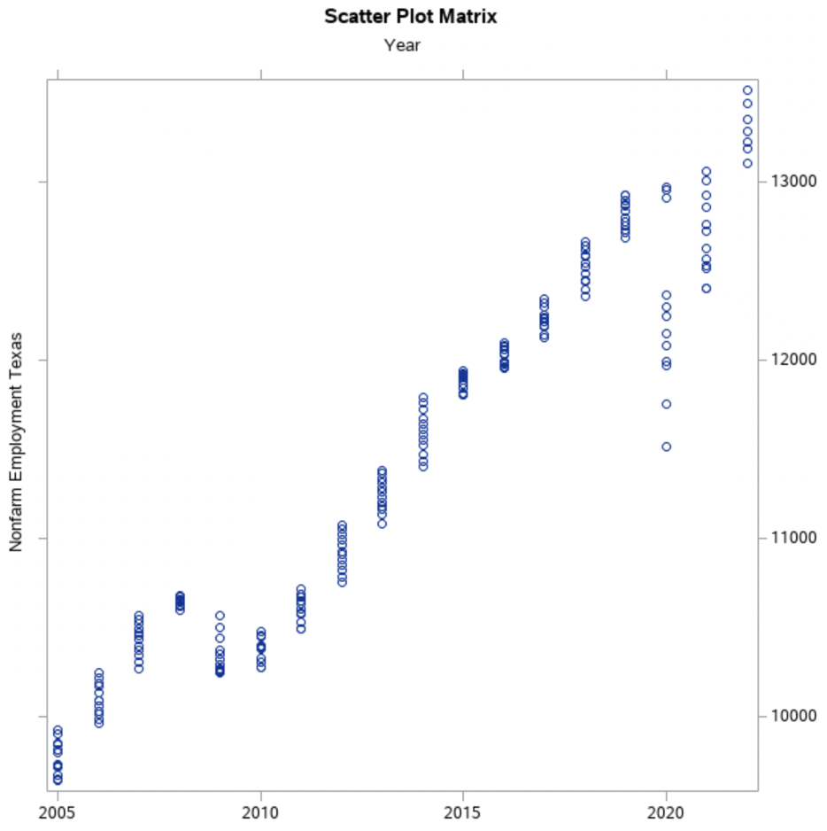
Analysis of Findings: Employment
Employment plays a significant role in determining the transportation habits of individuals in Dallas. Employment opportunities have steadily increased year-over-year (YOY); however, the data does show a wider gap in nonfarm employment opportunities from 2020 to 2022 indicating a mild employment recovery post-COVID-19. It also indicates the work from home (WFH) opportunities with employers out of state, which can impact the creation of adding employment in traditional brick-and-mortar locations.
Employment Migration
Opportunities greater in suburban areas vs urban areas
Businesses are dwindling in urban areas
Businesses and employment increase along cycling infrastructure
Employment
Transportation
Cities are being built for cars and not people
Urban residents forced to drive to work and shops
As gas prices are not impacted by employment
Investment in vehicle infrastructure continues to be focus
Housing
Housing Migration
Housing values increase when near cycling infrastructure
Housing values higher in suburban areas
Housing values return as urban areas are revitalized
Notes:
The objective of this study is to examine the viability of increased cycling infrastructure through the reduction of vehicle lane space, vis-a-vie, changing the approach to urban mobility in Dallas. While cities across the United States, as well as in Europe, have implemented cycling infrastructure in lieu of motorized vehicle infrastructure, and have realized increases in economic development and heightened community connectivity, Dallas has lagged in its efforts to invest in the necessary infrastructure as means to enhance its economic development and community connectivity.

Slide 9
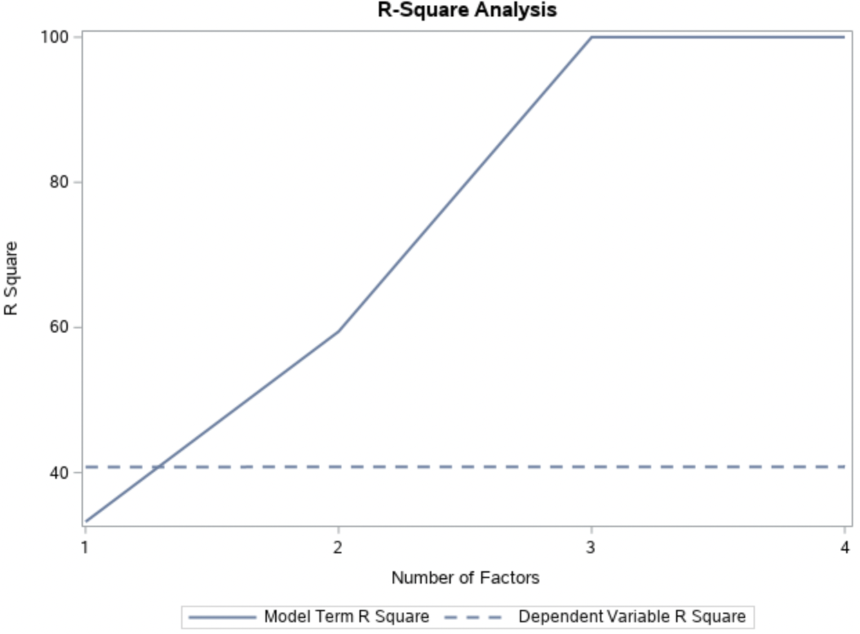
Analysis of Findings: Transportation
Transportation, whether it be commuting to work or driving to the grocery store, does require individuals to maintain a vehicle, which includes filling the tank with gas. The analysis indicates as the number of employment opportunities increase, so too do the factors that drive home sales. Therefore, there is a greater confidence level to predict that as employment increases, existing home sales will increase. If this concept is applied to urban areas, then vehicle use can decrease if cycling infrastructure is available.
Employment Migration
Opportunities greater in suburban areas vs urban areas
Businesses are dwindling in urban areas
Businesses and employment increase along cycling infrastructure
Employment
Transportation
Cities are being built for cars and not people
Urban residents forced to drive to work and shops
As gas prices are not impacted by employment
Investment in vehicle infrastructure continues to be focus
Housing
Housing Migration
Housing values increase when near cycling infrastructure
Housing values higher in suburban areas
Housing values return as urban areas are revitalized
Notes:
In review of the Least Squares Model specific to an Analysis of Variance that leveraged the same TCPA data, the p-value is calculated to <.0001 indicating a strong statistical significance that gas prices are not influenced by year. Returning to the nonfarm employment plot, this would mean that individuals would be forced to accept the opportunity cost of [potentially] higher costs to fill the tank in order to drive their vehicle for commuting, running errands, or both.

Slide 10
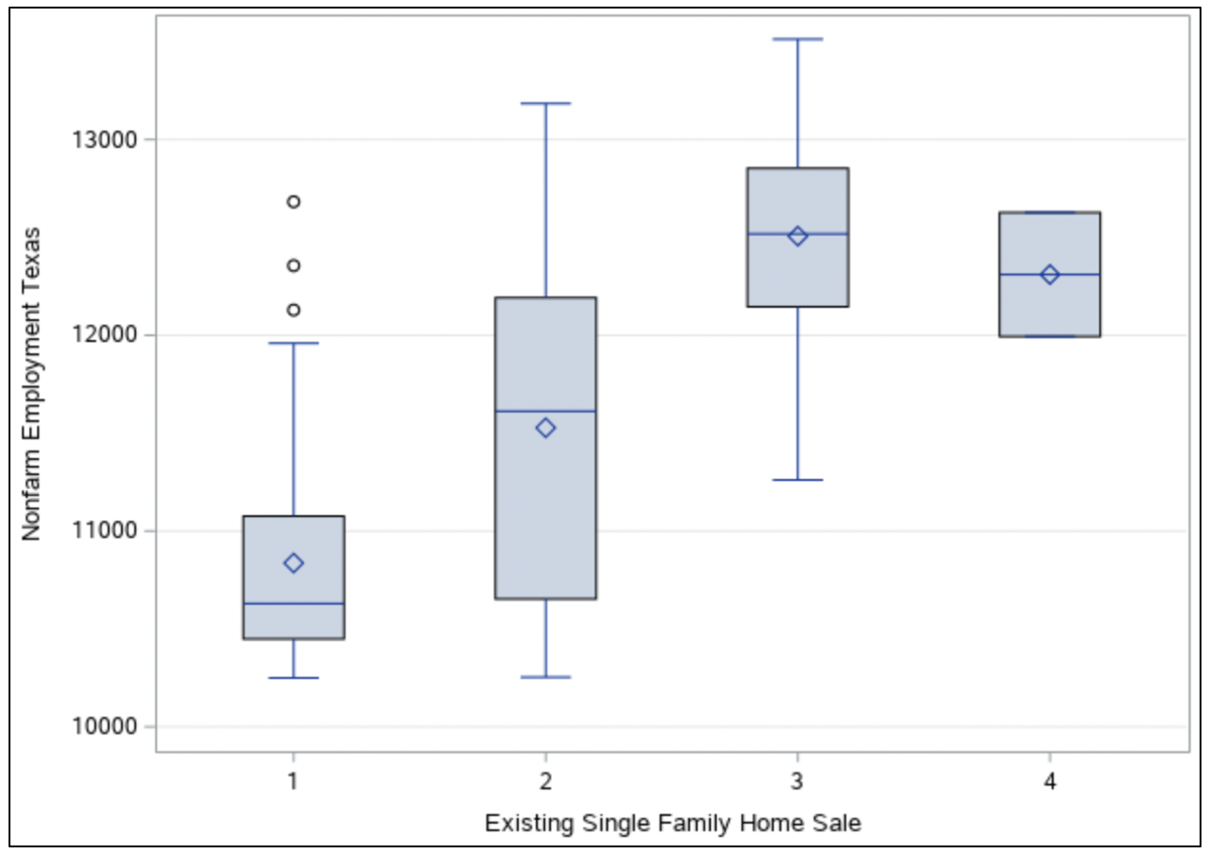
Analysis of Findings: Housing
Housing cost trends higher on the outer limits of a given city, which in turn can create additional inequities for residents of urban areas, e.g., mobility difficulties. For every quarter mile nearer to cycling infrastructure, property values can increase approximately $510 (Andersen, 2014). The scenario is like the AlQuhtani and Anjomani (2019) conclusion that home values throughout DFW are positively impacted when located near rail stations.
However, this is an example highlighting the Braun (2021) view of potentially widening the sociodemographic disparities in cycling and its benefits if non-infrastructure barriers to cycling are not also addressed by urban planners.
Employment Migration
Opportunities greater in suburban areas vs urban areas
Businesses are dwindling in urban areas
Businesses and employment increase along cycling infrastructure
Employment
Transportation
Cities are being built for cars and not people
Urban residents forced to drive to work and shops
As gas prices are not impacted by employment
Investment in vehicle infrastructure continues to be focus
Housing
Housing Migration
Housing values increase when near cycling infrastructure
Housing values higher in suburban areas
Housing values return as urban areas are revitalized
Notes:
Where people live within Dallas is another component that plays a significant role in determining how people leverage transportation. With a county population of 2,613,539 and an area of 909 square miles (United States Census Bureau, 2021), connecting communities via primary and secondary arterial roads all but invites motorized vehicles to be the primary means of transportation and seemingly supports the Hortas-Rico (2015) observation regarding migration to housing located on the outer limits of Dallas.
As people locate to the outer edges of Dallas, driving higher housing costs and furthering employment inequities for residents of urban areas, the migration cycle will leave behind groups of individuals without the necessary strategic investment to bolster utilitarian cycling and economic development within urban areas of Dallas. Bike lanes are more prominent in new development communities versus communities experiencing economic declines, which further impedes the process to connect communities through cycling infrastructure if the full breadth of connectivity is not explored by urban planners to make cycling infrastructure a priority for the city of Dallas’s 1,304,442 residents (United States Census Bureau, 2021).

Slide 11
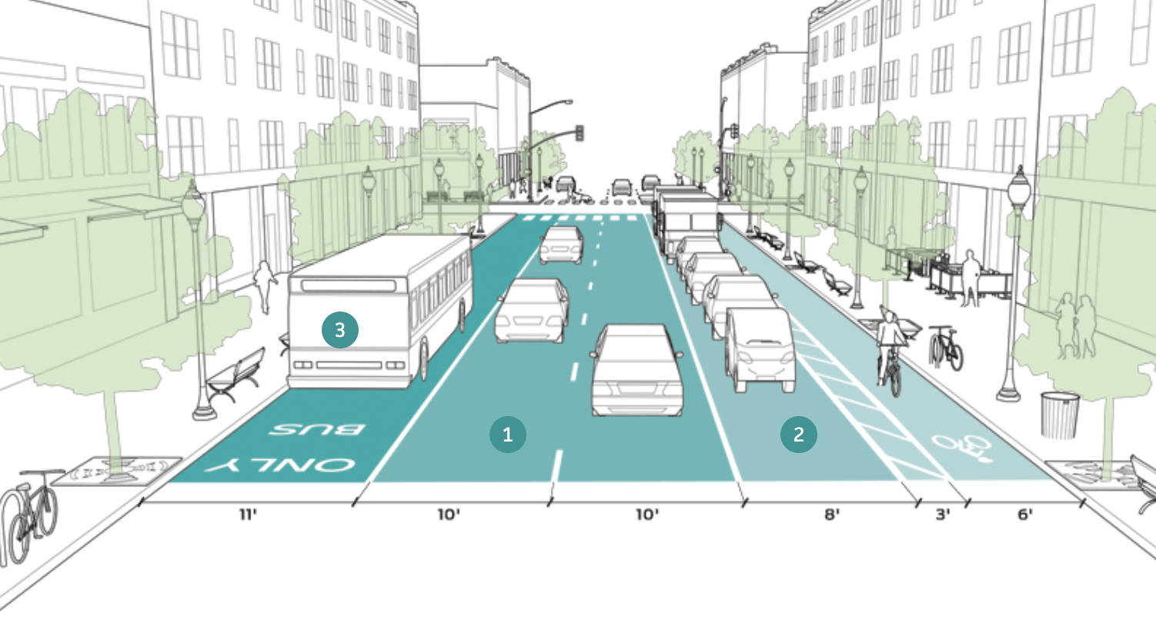
Conclusion
The study set out to test the viability of reducing the physical space drivers have today on arterial roads in Dallas and reallocate the residual space for protected cycling infrastructure. The study makes a strong argument that the factors impacting transportation infrastructure, specifically, housing and employment, have a strong statistical connection. The study then looked at successful cycling infrastructure implemented in other cities that concluded a strong correlation with positive economic development once cycling infrastructure was set into place. Space can be redistributed without requiring major construction to relocate buildings or communal sidewalk space.
A reduction in lane size to 10 feet wide and reducing the number of vehicle lanes to two can yield room for a 9-foot-wide protected bike lane in conjunction with:
The ability to still maintain moving vehicle traffic patterns
A single side parking that doubles as an added physical barrier protecting the bike lane
An optional bus lane that can further promote public transportation and aid in addressing the inequities to get to where employment opportunities reside in Dallas.
NACTO post arterial urban design street, 2022. In the public domain: https://nacto.org/publication/urban-street-design-guide/street-design-elements/lane-width/#:~:text=Travel%20lane%20widths%20of%2010,lanes%20in%20the%20opposing%20direction.
Notes:
To address the overall economic and social inequities, the study concludes with a successful prediction suggesting a higher probability of success for reducing the physical space for car lanes to reallocate to protected cycling infrastructure as a viable option for economic redevelopment of Dallas’s urban areas. The analysis supports the alternative hypothesis that there is evidence to support reducing car lane size to reallocate to protected bike lanes; however, additional research in the form of a sentiment analysis can be conducted to identify adoption probabilities.

Slide 12
Recommendations
The final recommended solution for city leaders is to maintain status quo as it pertains to new development; however, there is ample opportunity to address Dallas’s existing urban area to reinvigorate the economy, entice people to buy property, and promote a cycling culture.
Cycling
Infrastructure
Connecting
Communities
Research can impact policy if the analysis is conveyed properly
Notes:
Because space is a commodity in an urban setting, the best viable option is to reduce the width of vehicle and parking lanes from 12 feet to 10 feet and reallocate the remaining free space to protected cycling infrastructure. Reducing the space will also help promote slower driving speeds, which can positively impact the severity of inevitable crashes. A narrow street can also reduce the distances pedestrians must walk to cross the street it can allow for a shorter signal cycle (NACTO, 2022). Figure 9 depicts typical existing arterials across many large urban areas, including Dallas. These arterials often have two to three lanes of moving traffic and one to two lanes of parking, with all four lanes each having a width of 12 feet wide.

Slide 13
References
A New Dallas. (2021). Traffic. Retrieved from A New Dallas: https://www.anewdallas.com/traffic.html
AlQuhtani, S., Anjomani, A. (2019). Do rail transit stations affect housing value changes? The Dallas Fort-Worth metropolitan area case and implecations. Journal of Transport Geography, 1-11.
Andersen, M., Hall, M.L. (2014). Protected Bike Lanes Means Business: how 21st Century Transportation Networks Help New Urban Economies Boom. Washington, D.C.: Alliance for Biking & Walking, People for Bikes.
Braun, L. (2021). Disparities in Bicycle Commuting: Could Bike Lane Investment Widen the Gap? Journal of Planning Education and Research.
Cunha, I., Silva, C. (2022). Equity impacts of cycling: examining the spatial-social distribution of bicycle-related benefits. International Journal of Sustainable Transportation, 1-19.
Firth, C.L., Hosford, K., Winters, M. (2021). Who were these bike lanes built for? Social-spatial inequities in Vancouver's bikeways, 2001-2016. Journal of Transport Geography, 1-10.
Florida, R., McLean, J.W. (2017, July 11). Business and Society: What Inclusive Urban Development Can Look Like. Retrieved from Harvard Business Review: https://hbr.org/2017/07/what-inclusive-urban-development-can-look-like
Hortas-Rico. (2015). Sprawl, Blight, and the Role of Urban Containment Policies: Evidence from U.S. Cities. Journal of Regional Science, 298-323.
Notes:
Reference slide.

Slide 14
References
NACTO. (2022). Urban Street Design Guide. Retrieved from National Association of City Transportation Officials: https://nacto.org/publication/urban-street-design-guide/street-design-elements/lane-width/#:~:text=Travel%20lane%20widths%20of%2010,lanes%20in%20the%20opposing%20direction.
Texas Comptroller of Public Accounts. (2020). Retrieved from The Metroplex Region: 2020 Regional Report: https://comptroller.texas.gov/economy/economic-data/regions/2020/metroplex.php
United States Census Bureau. (2021, November 19). American Community Survey: Methodology. Retrieved from United States Census Bureau: https://www.census.gov/programs-surveys/acs/methodology.html
Van Eijk, R.P.A., Roes, K.C.B., Van den Berg, L.H., Lu, Y. (2022). Joint modeling of endpoints can be used to answer various research questions in randomized clinical trials. Journal of Clinical Epidemiology, 32-39.
Notes:
Reference slide.

